Slide 1
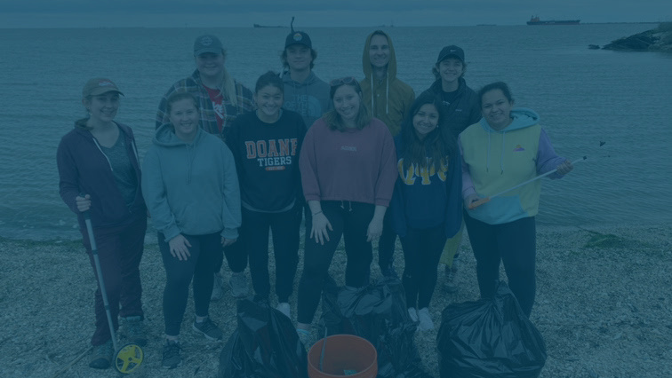
DOANE SERVES
Alternative Breaks

Slide 2
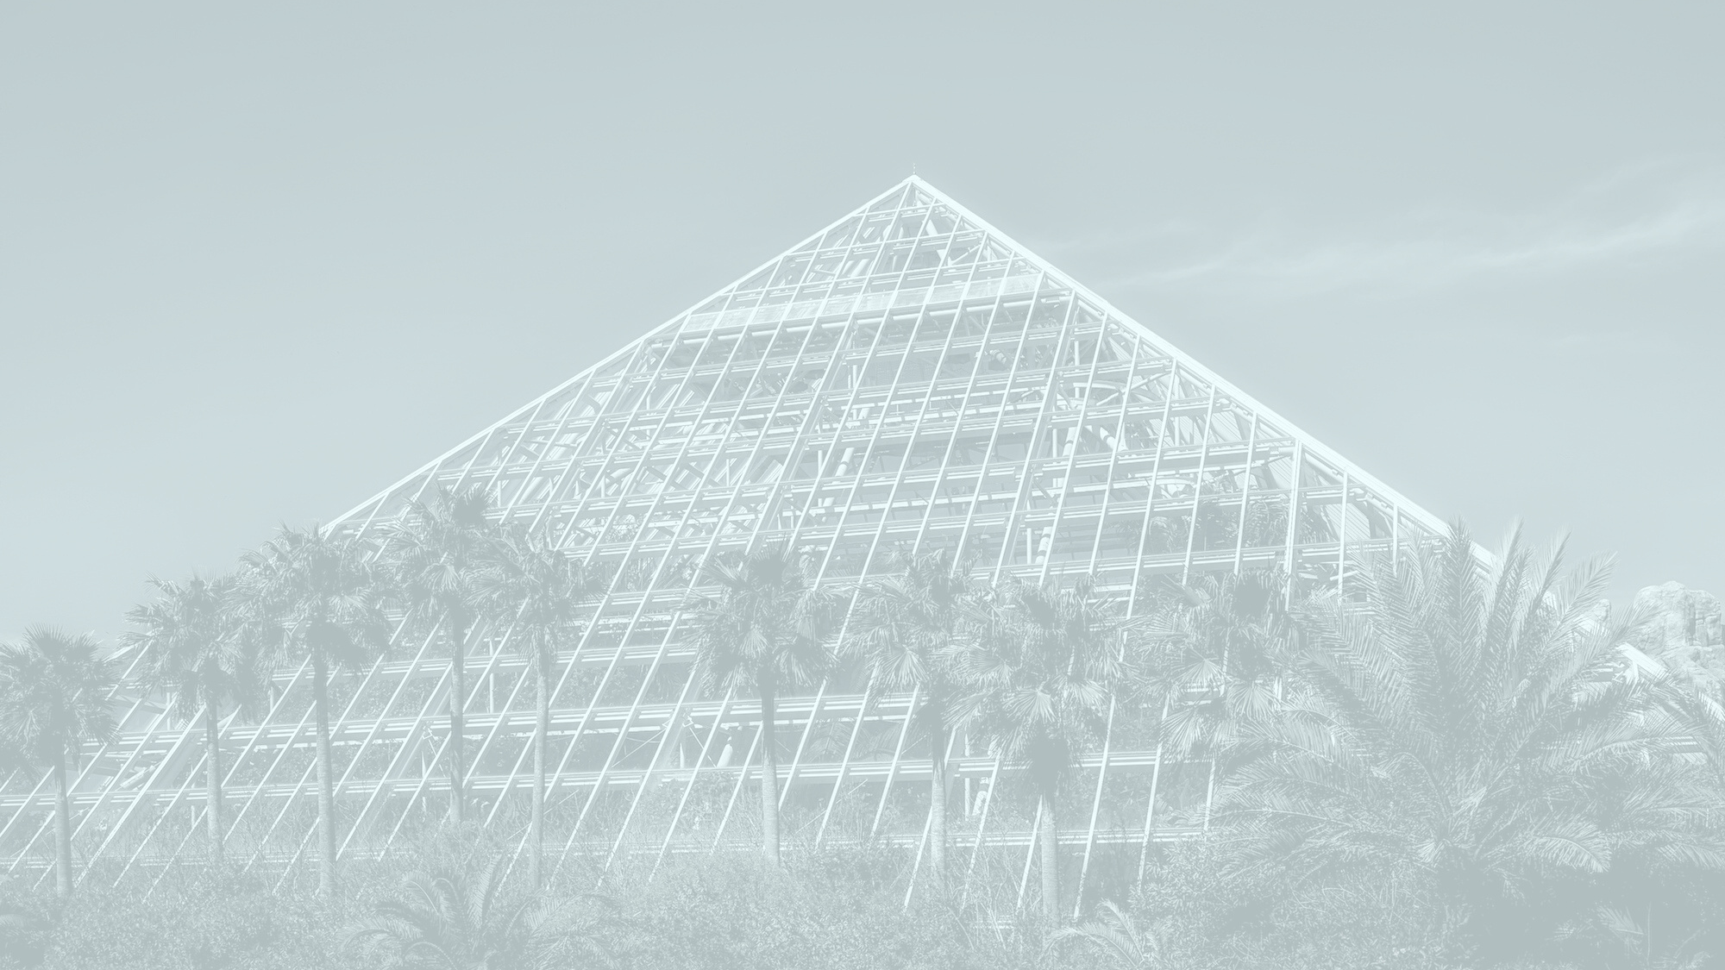
ALTERNATIVE SPRING BREAK 2022
Galveston, TX

Slide 3
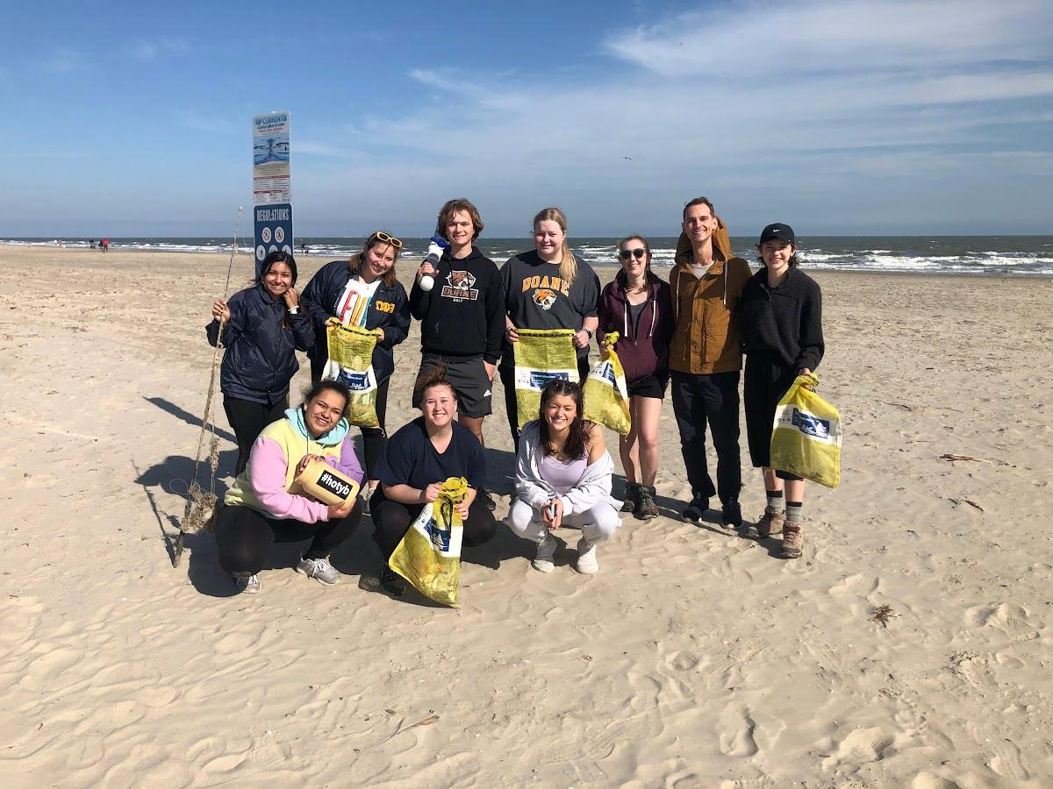
The Group
1 DOANE SERVES SITE LEADER
MADDIE BRANDENBURG - SENIOR
8 DOANE STUDENTS
2 SENIORS, 4 SOPHOMORES, 2 FIRST-YEARS
1 DOANE STAFF MEMBER
NICK KNOPIK, ASSISTANT DIRECTOR OF LEADERSHIP & SERVICE

Slide 4
MEET OUR GALVESTON-AREA NON-PROFIT PARTNERS

Slide 5
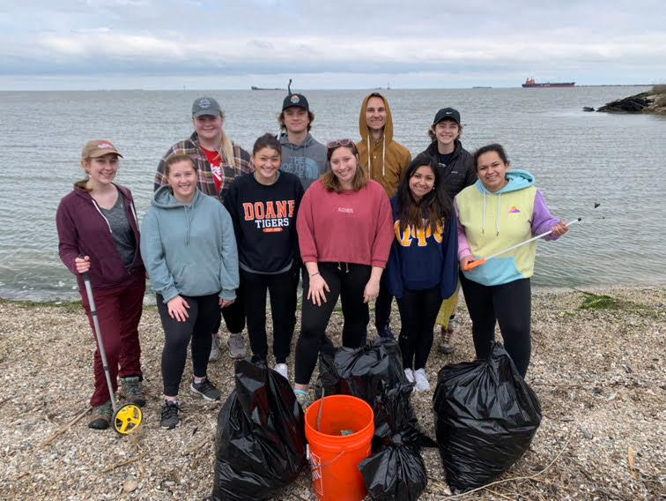
GALVESTON BAY FOUNDATION
Participating in Conservation Research at Seawolf Park
Galveston Bay Foundation staff showed the group a 100-yard research plot where trash and debris washes up and is meticulously collected and documented. Students collected over 50 lbs of trash and recorded each item in a NOAA Marine Debris Tracker app so the information can be used for environmental research.

Slide 6
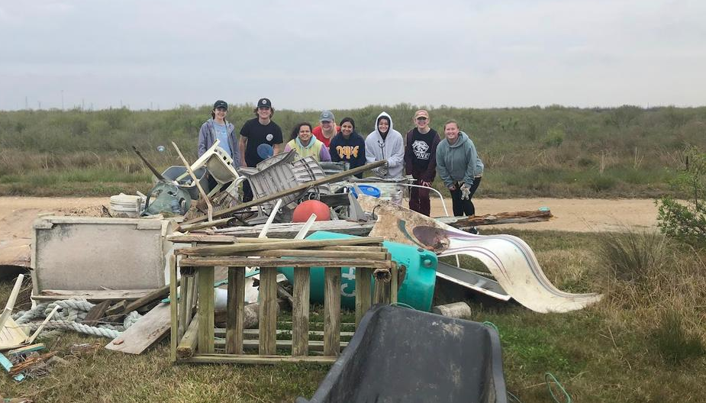
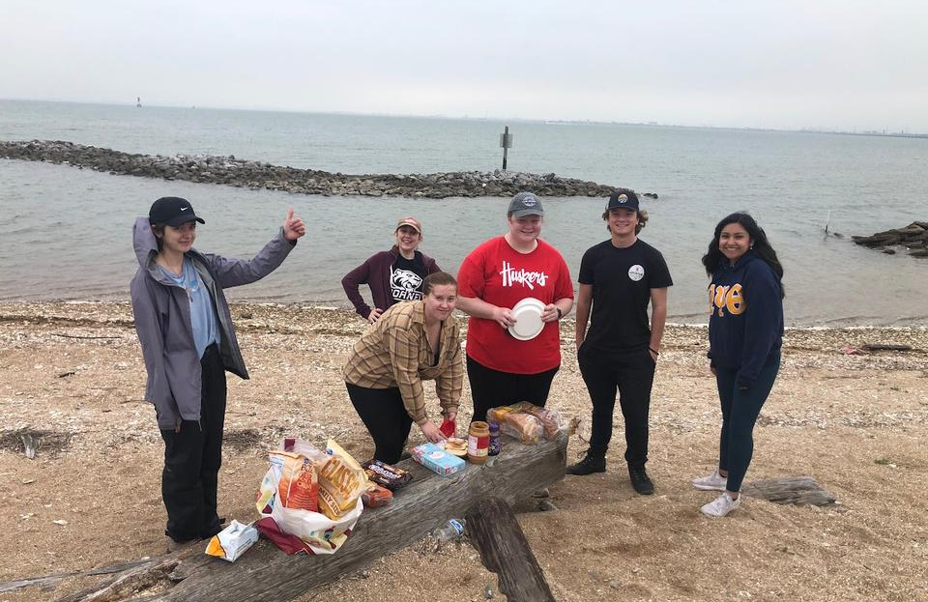
SCENIC GALVESTON
Restoring Hurricane-Affected Natural Wetlands
By far the most labor-intensive day of the trip, students worked for 6 hours clearing debris out of housing lots that have been destroyed by hurricanes and abandoned. The lots exist on natural wetlands that serve as nesting grounds for over 100 species of birds.
Students got to enjoy a scenic lunch on a pebble beach overlooking the Galveston Bay and learn about many of the species of birds native to the area from our non-profit partner at Scenic Galveston.

Slide 7
TURTLE ISLAND RESTORATION NETWORK
Cleaning Nesting Grounds for Sea Turtles
Students learned about environmental risks to sea turtle nesting habitats and the human-caused pollution that threatens these animals. The group spent the afternoon cleaning up the beach where these sea turtles make their nests.

Slide 8
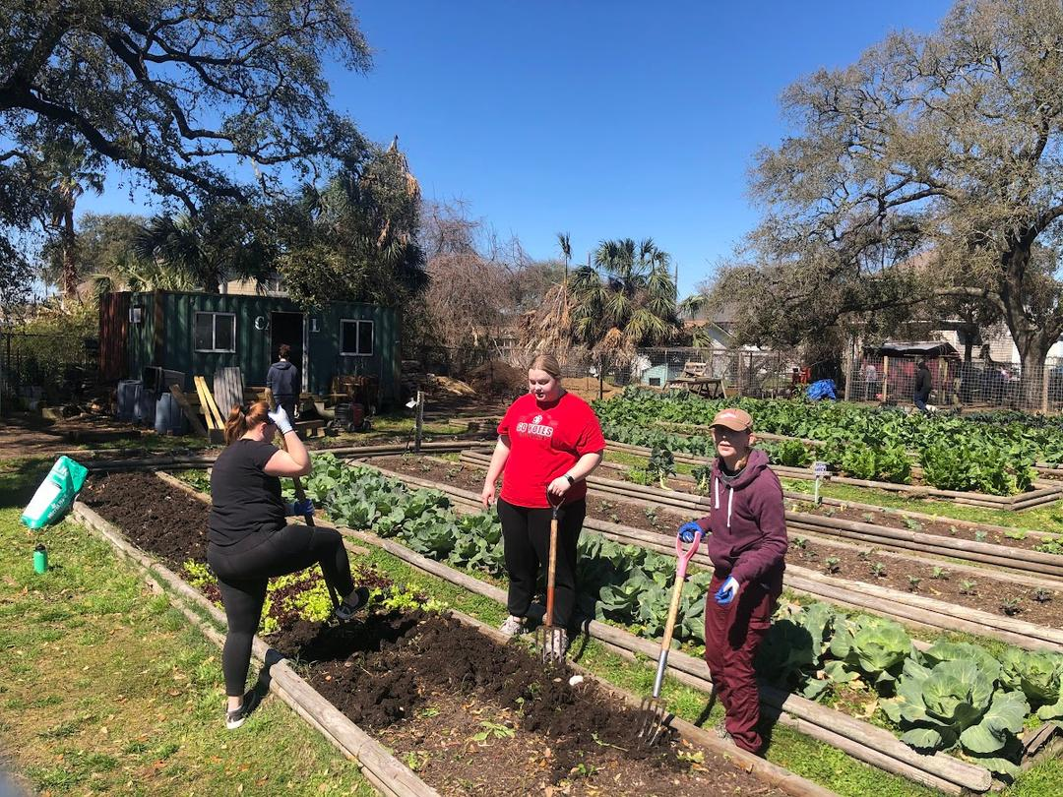
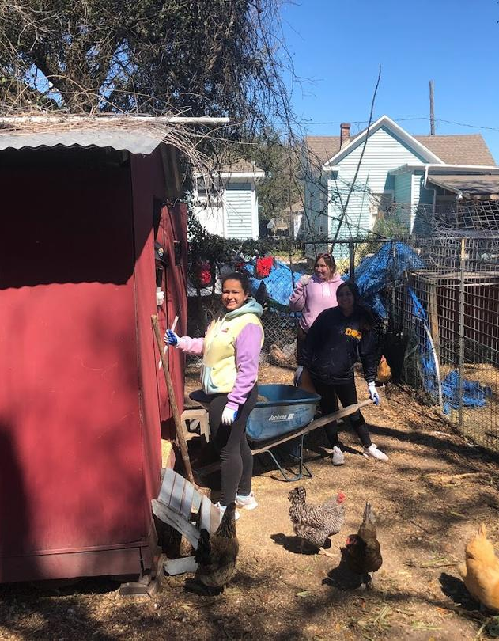
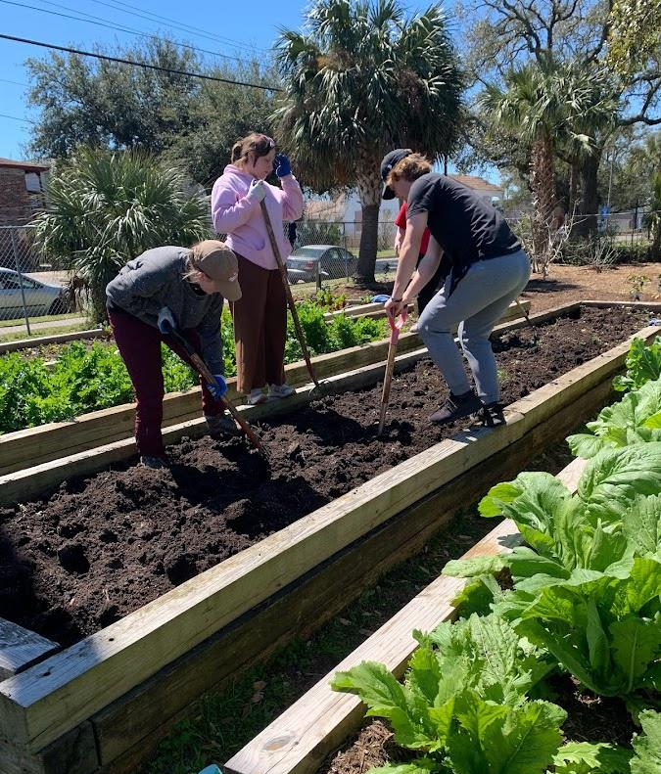
SEEDING GALVESTON
Prepared a Community Garden for Summer Crops
The group harvested kale, carrots, and lettuce, turned over the gardening beds, and planted various summer vegetables. Students were able to interact with various community members who receive food from the community garden.

Slide 9
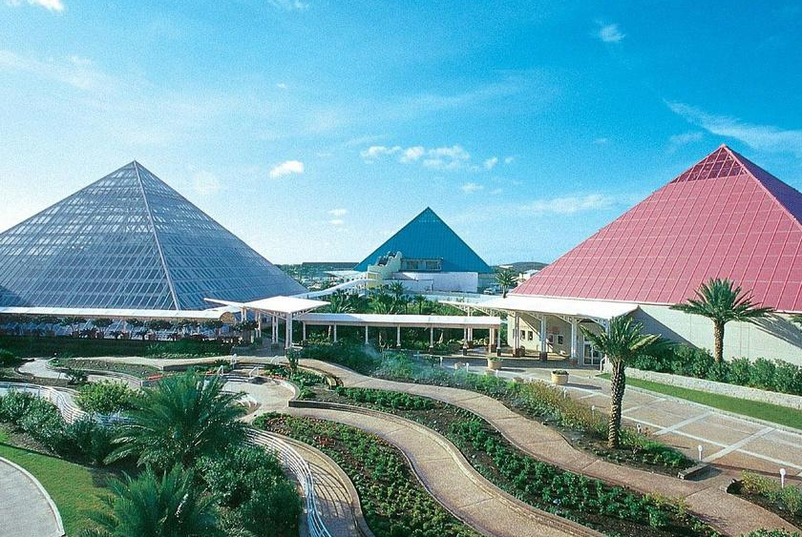
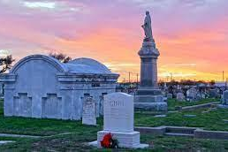
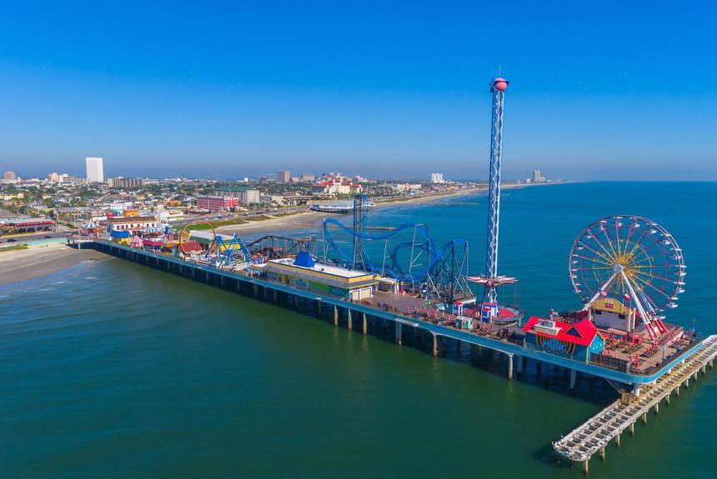
EXPLORING GALVESTON
PLEASURE PIER
MOODY GARDENS
HAUNTED TOUR
Enjoyed Galveston's famous pier with rides, attractions, and spectacular views of the Gulf of Mexico.
Explored a rainforest inside of a giant glass pyramid that featured monkeys, sloths, and giant Amazon fish.
Students learned about the haunted history of Galveston at a ghost tour in a local cemetary.

Slide 10
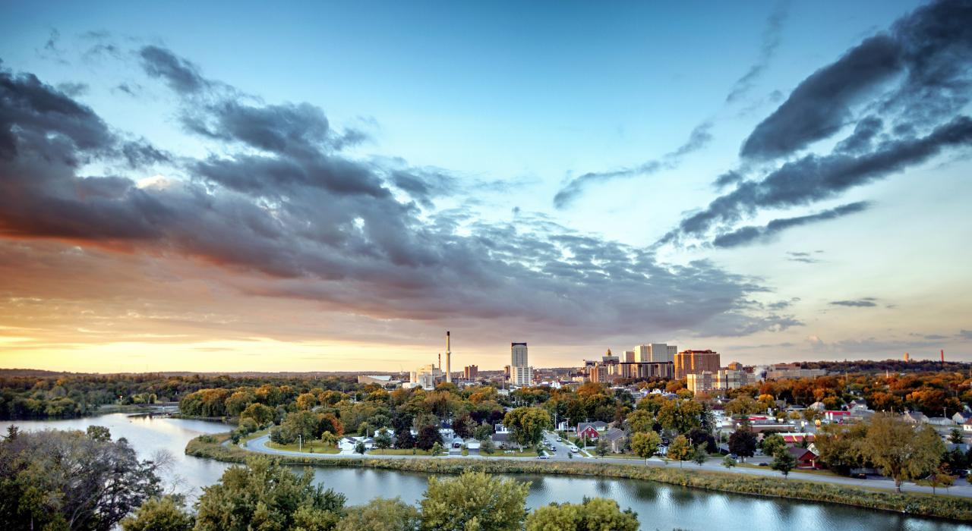
ALTERNATIVE FALL BREAK 2022
Rochester, MN

Slide 11
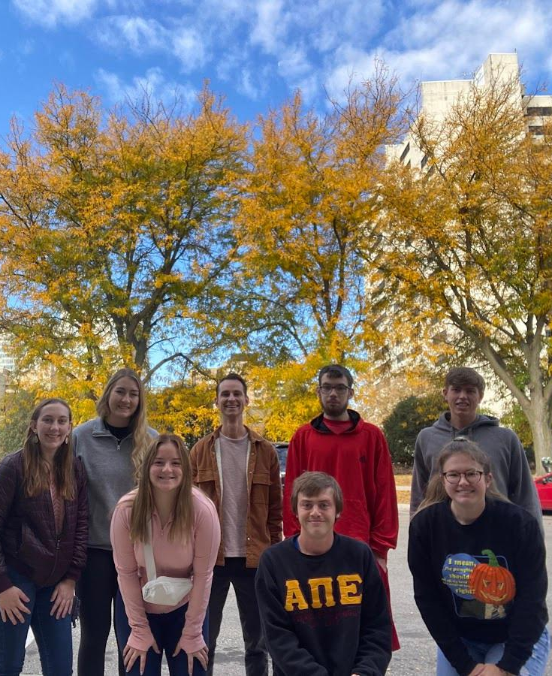
The Group
1 DOANE SERVES SITE LEADER
ABRIANNA MILLER, SENIOR
6 DOANE STUDENTS
2 FIRST-YEARS, 2 JUNIORS, 2 SENIORS
1 DOANE STAFF MEMBER
NICK KNOPIK, ASSISTANT DIRECTOR OF LEADERSHIP & SERVICE

Slide 12
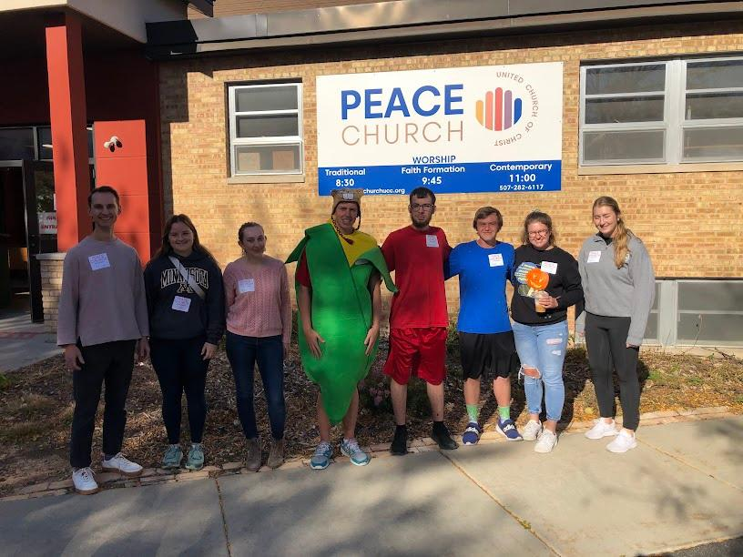
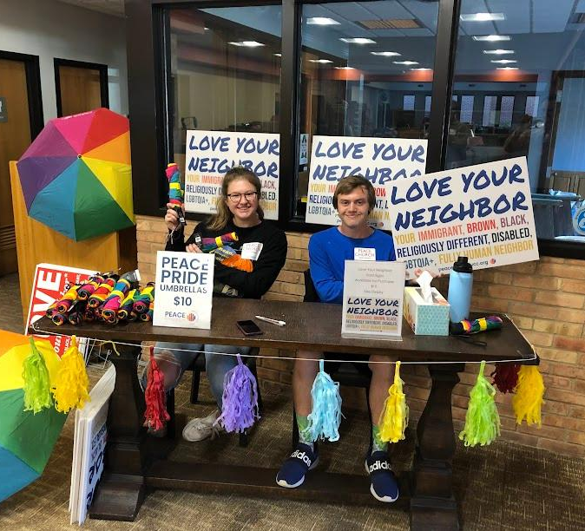
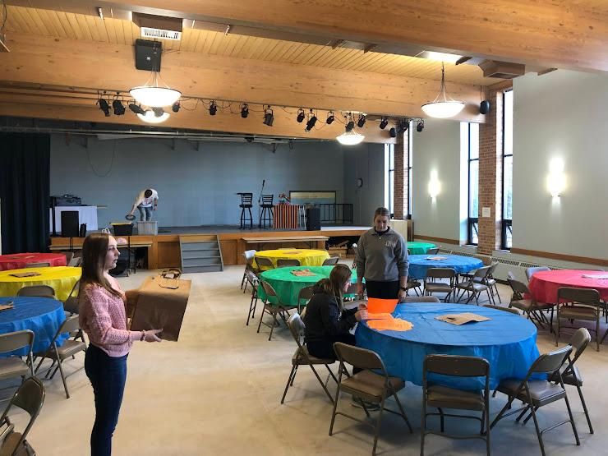
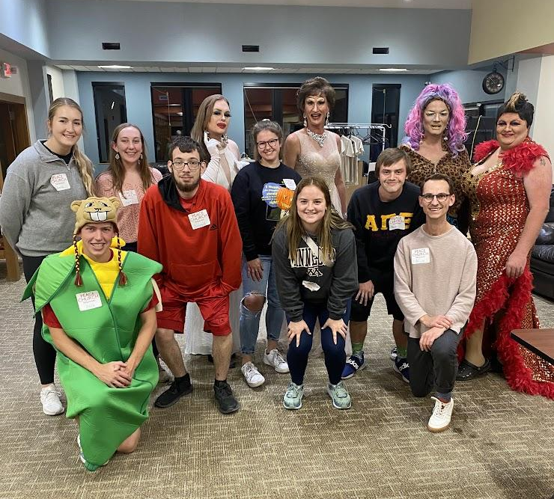
DRAG QUEEN BINGO - PEACE CHURCH
Students volunteered to assist with a bingo event that raised money for Peace United Church of Christ and provided an inclusive space for community members to enjoy a fun evening of bingo and performances by local drag queens. Students took tickets, worked concessions, adjudicated the bingo games and walked attendees to their cars after the event.

Slide 13
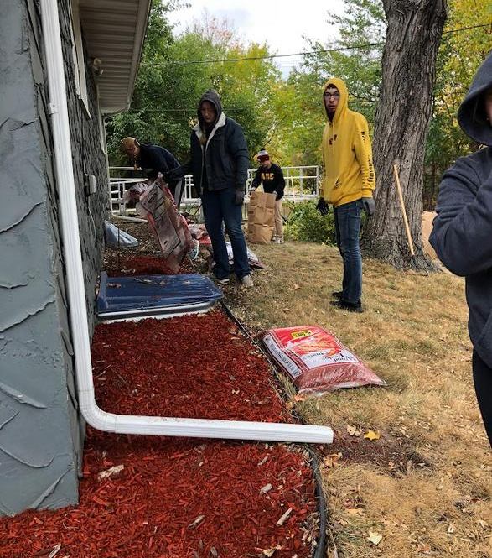
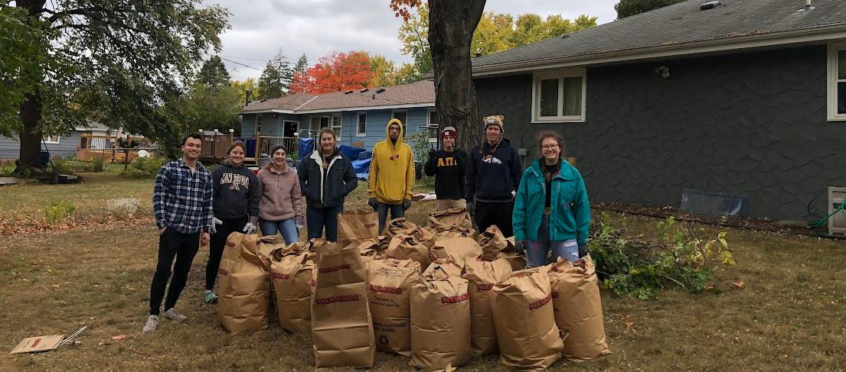
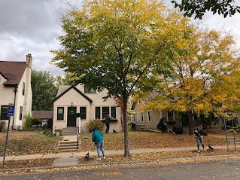
WINGSPAN - CLEANING GROUP HOMES
Students cleaned the outside of group homes for adults with disabilities. The group bagged leaves, spread mulch, and trimmed trees to prepare the homes for winter.

Slide 14
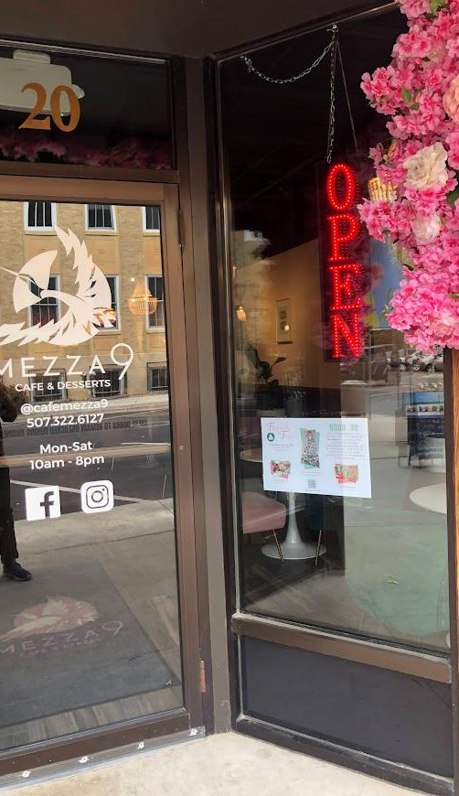
HIAWATHA HOMES - VOLUNTEERING IN GROUP HOMES
Groups of students were invited into the homes of adults with disabilities and spent the day playing games with the individuals and getting to know them. Other students promoted Hiawatha Homes' Festival of Trees, a large fundraising event, by putting up flyers in downtown Rochester.

Slide 15
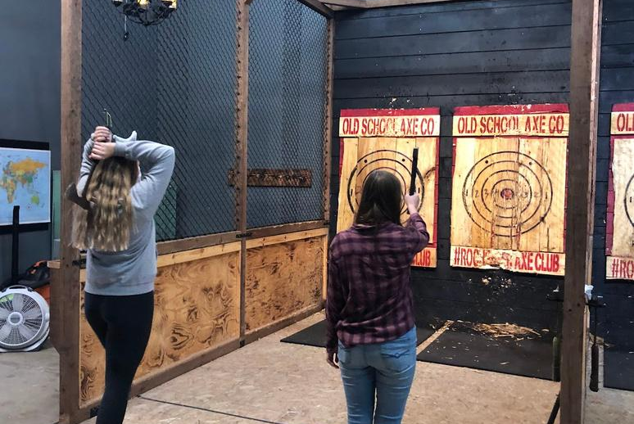
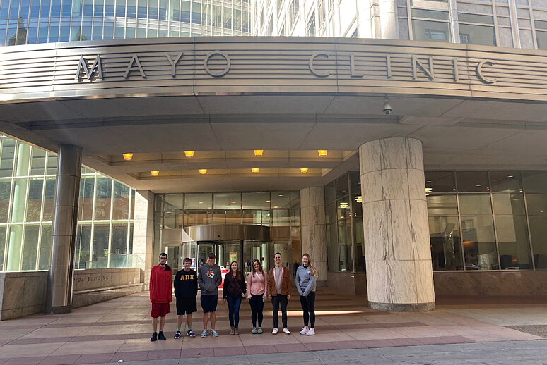
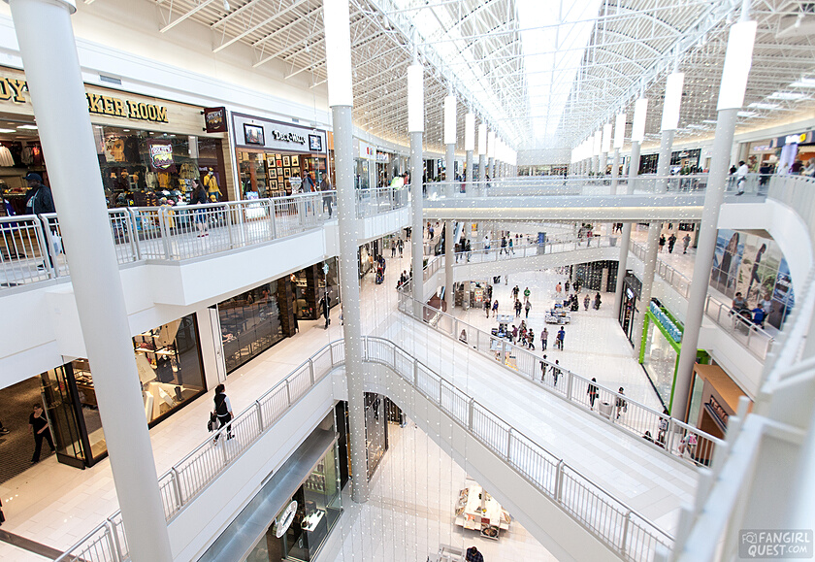
EXPLORING ROCHESTER
AXE THROWING
MAYO CLINIC
MALL OF AMERICA
To kick off the trip, the group had dinner and went axe throwing at an arcade in Rochester.
The group took a self-guided tour of Mayo Clinic and explored Rochester's surprisingly bustling downtown scene.
The group visited Mall of America - many of the students' first time at the largest mall in the U.S.

